Slide 1


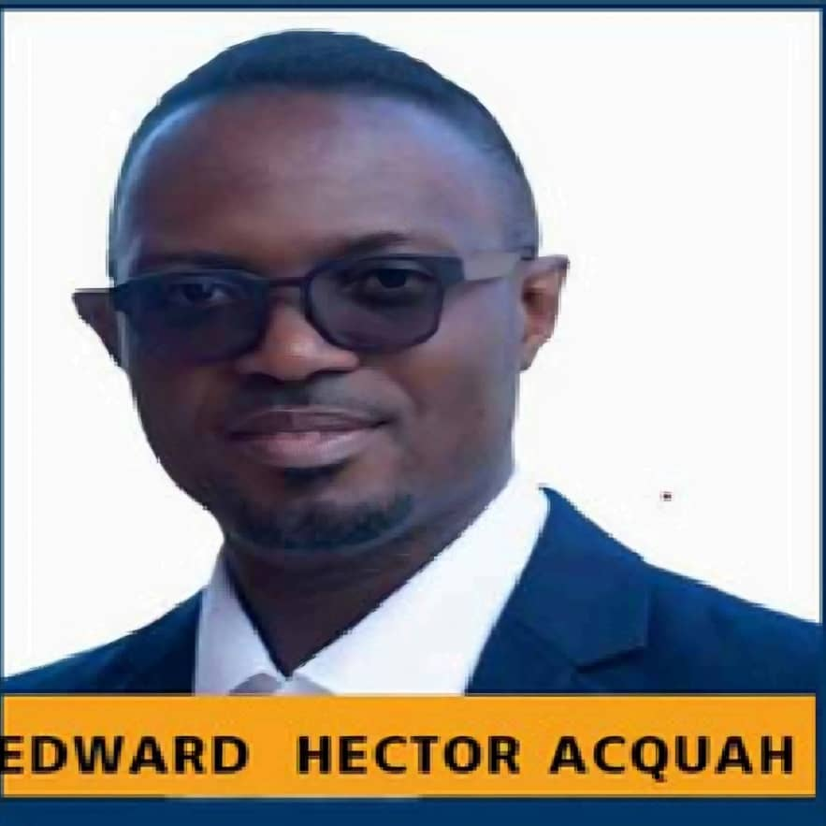
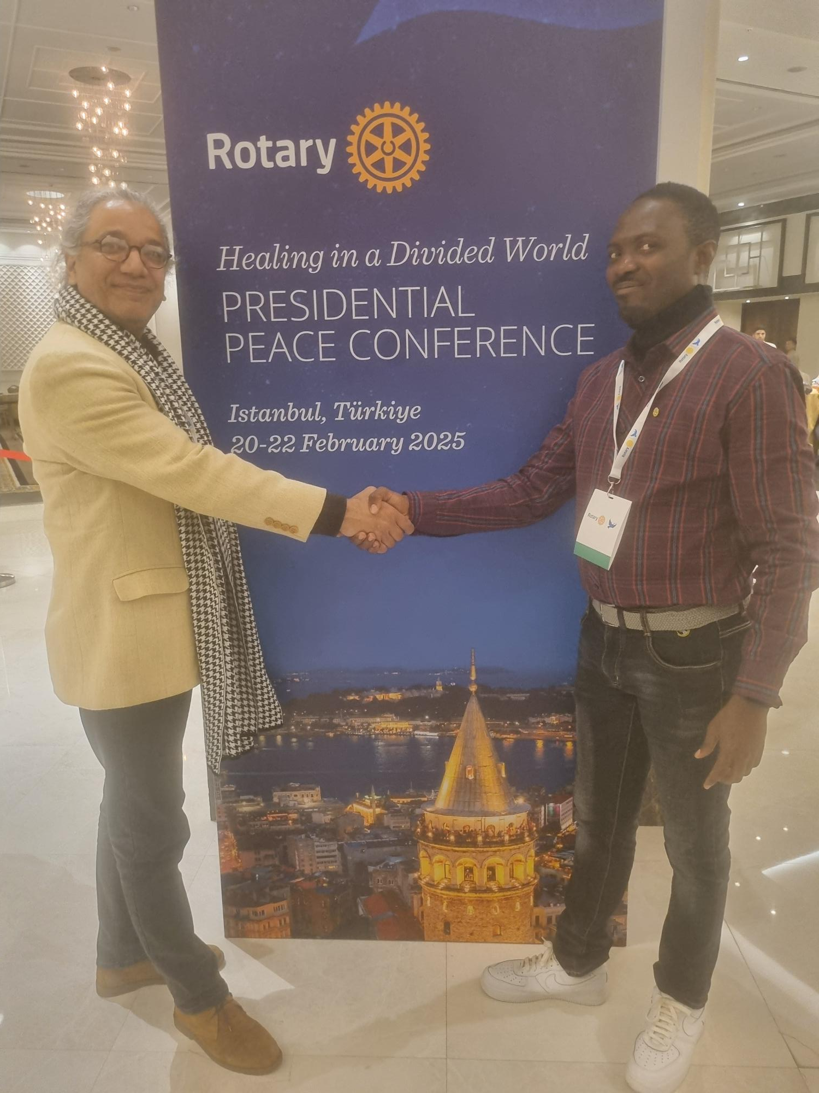
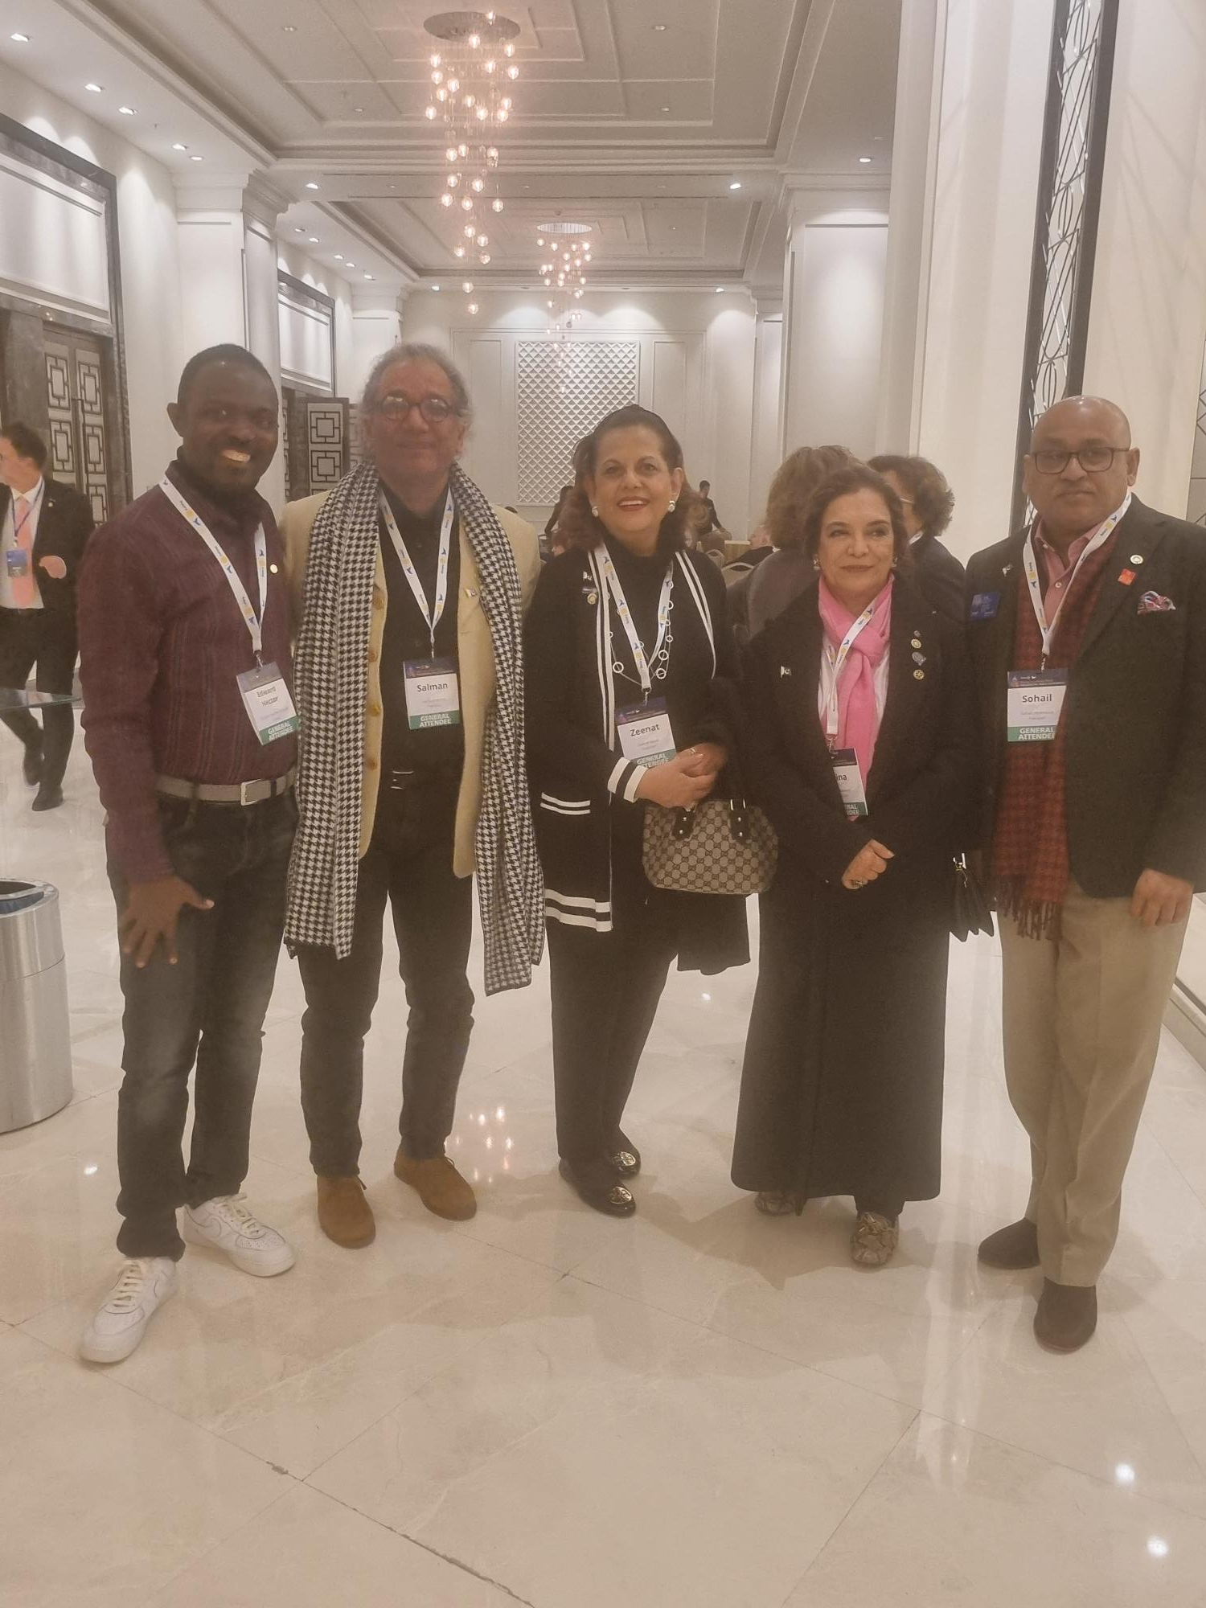
Getting to Know Me
Work
Personal
My role
Accounts Manager
Significant others / family members / furry friends in my life
Anita my wife , school old friend ,church friends, my mentors and Rotary club members
Tenure in ofi/Olam
18 years with ofi/Olam
How I enjoy spending my free time
I spend most of my time at home with my family, occasional go out with for a tour and swimming
Previous companies I have worked at
I have work with KASSIG study school and Rural Aid Alliance foundation with Family health international
My favorite / comfort food
I like fisher man stew with eba and fante kenkey
Why I joined ofi/Olam and what keeps me here?
I joined ofi because I wanted to work with cocoa bean company . I am still working with ofi because ofi sees my value of work and also I see my career growth in ofi. Ofi has good and stilled leaders who inspires me.
My favorite song
Ghanaian gospel music, raggae and orchestral music
Edward Hector Acquah
‘Eddie’
I am very curious and like to explore
This is me outside work, doing stuff I enjoy in my life …

